Slide 1
SHEQ Safety Performance Board Pack
Safety Energy, event hotspots, and leadership action priorities
Scope
Events: 08 Jul 2023 to 31 Dec 2025 | Safety Energy: 01 Jan 2024 to 31 Dec 2025
Events
2621
Moderate+ Events
88
MV Events
279
CCC Avg Quality
28.2
Generated
09 April 2026

Slide 2
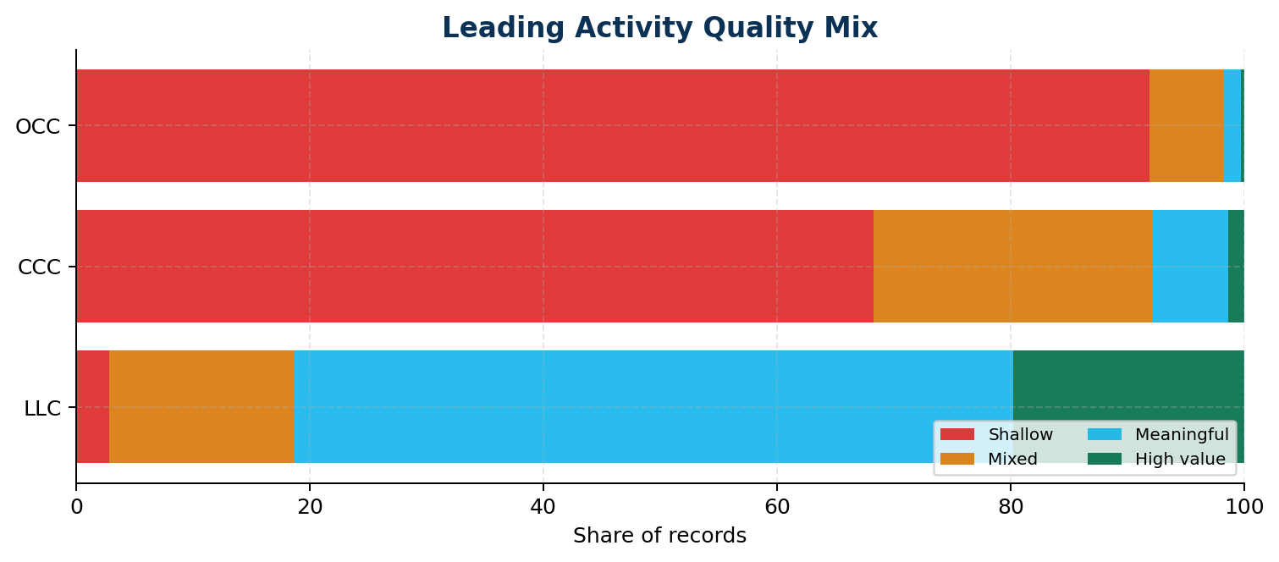
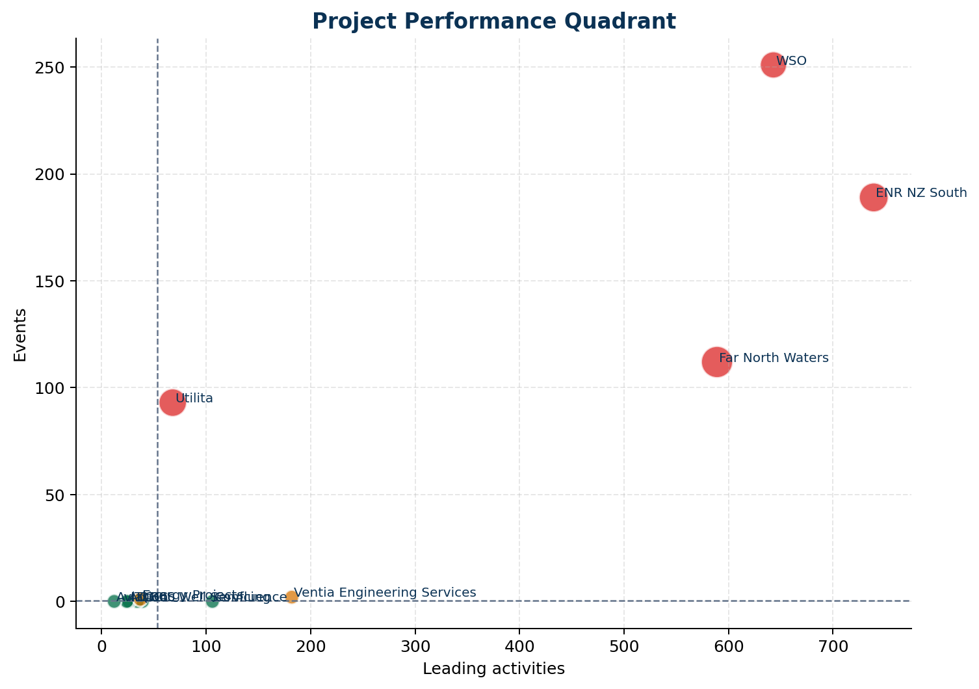
Executive Summary
What leaders should know right now
Key Messages
CCCs averaged a quality score of 28.2/100 over the last 24 months, with 68.3% assessed as shallow and 1.4% assessed as high value.
Resources shows a high-volume / low-value pattern in CCC activity: 2869 records with average quality 28.7 and 67.7% shallow entries.
Emerging Safety Energy themes in the recent six months include Grinder, Quality Inspection Checklist, Thermal Stress.
LLC records currently show the strongest overall documentation quality among the three leading activity types.
Priority Actions
Moderate-or-above consequence events make up 3.4% of recorded events. Review whether controls around the highest-consequence scenarios are being verified often enough in field activity.
31 Lost Time Injuries were recorded in the analysis window. Review the underlying work types, contributing factors, and recovery actions for common patterns.
Serious events are most frequently recorded in Afternoon (12:00-17:59). Use this to target pre-start, supervision, and fatigue controls at the riskiest parts of the day.
Motor vehicle events account for 10.6% of all events. Review journey management, road conditions, and vehicle type patterns in the MVE section.

Slide 3
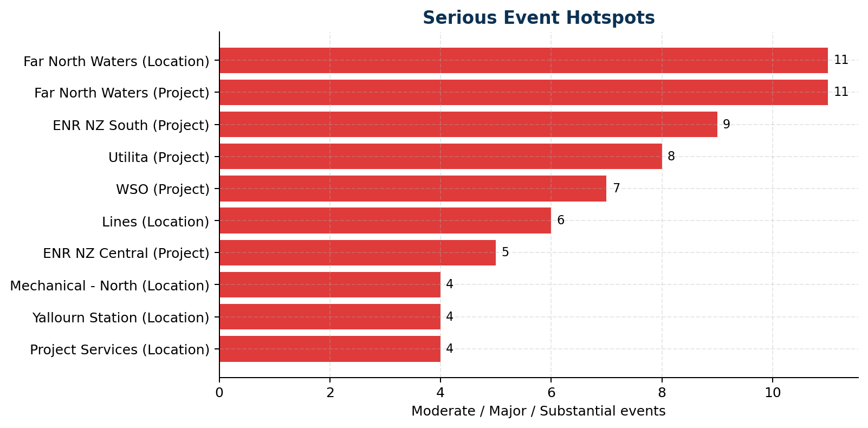
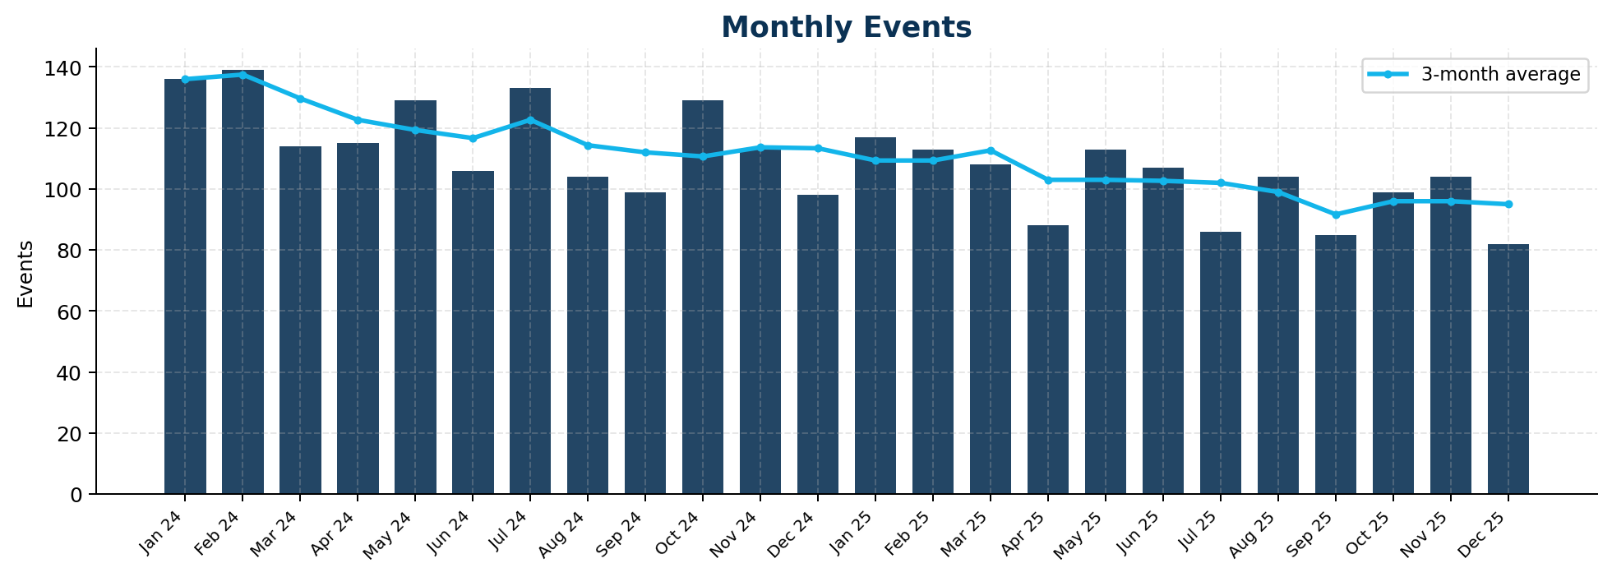
Event Hotspots
Where event burden and serious consequences are concentrated
Leadership Focus
Highest serious-event project: Far North Waters (11 serious events)
Most common serious-event timing: Afternoon (12:00-17:59) (40 events)
Motor vehicle events: 279 total, 7 moderate+

Slide 4
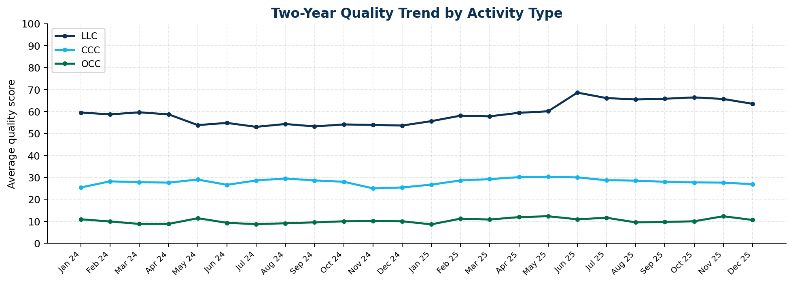
Leading Activity Quality
Whether LLC, CCC, and OCC records look meaningful and actionable
Quality Readout
CCC: quality 28.2/100, shallow 68.3%, follow-up 16.4%
OCC: quality 10.4/100, shallow 91.9%, follow-up 10.0%
LLC: quality 58.2/100, shallow 2.8%, follow-up 42.2%

Slide 5
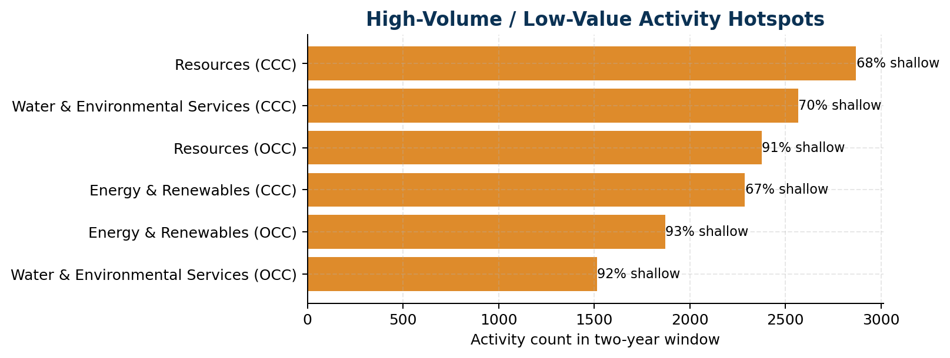
Projects and Locations
Which areas appear strongest and which need direct intervention
Watchlist
Project watch: Far North Waters | events 112 | serious 11
Project watch: ENR NZ South | events 189 | serious 9
Project watch: Utilita | events 93 | serious 8
Location watch: Far North Waters | events 112 | serious 11
Location watch: Lines | events 130 | serious 6
Location watch: Project Services | events 68 | serious 4

Slide 6
Recommended Actions
Executive actions generated from the analysis
Immediate Priorities
Moderate-or-above consequence events make up 3.4% of recorded events. Review whether controls around the highest-consequence scenarios are being verified often enough in field activity.
31 Lost Time Injuries were recorded in the analysis window. Review the underlying work types, contributing factors, and recovery actions for common patterns.
Serious events are most frequently recorded in Afternoon (12:00-17:59). Use this to target pre-start, supervision, and fatigue controls at the riskiest parts of the day.
Motor vehicle events account for 10.6% of all events. Review journey management, road conditions, and vehicle type patterns in the MVE section.
Prioritise a motor vehicle risk review for Yarra Valley Water O&M where MV exposure is most visible, with particular attention to Main Road driving conditions.
Next Priorities
Business Unit 'Sector Overhead' shows declining leading-activity volume in the recent period. Targeted engagement from the sector SHEQ team is recommended.
'Resources' has both high leading-activity and high event volumes. This may indicate reactive activity patterns — review whether conversations are targeting root causes rather than responding after the fact.
'Energy & Renewables' has both high leading-activity and high event volumes. This may indicate reactive activity patterns — review whether conversations are targeting root causes rather than responding after the fact.
'Water & Environmental Services' has both high leading-activity and high event volumes. This may indicate reactive activity patterns — review whether conversations are targeting root causes rather than responding after the fact.
Focus the next leadership review on project 'Far North Waters', which recorded 112 events and 11 serious events against 589 leading activities.

